Slide 1

Phase5 SW Release Plan
Roger Xu, Jiajia Zhou, James Chen
Date: Feb 05, 2021
Desired Outcome
Awareness
Decision
Escalation Help
Think
Point of view
Plan to Implement
Implement

Slide 2
Phase 5 Vehicles Timeline
2021 | 2022 | 2023
1 | 2 | 3 | 4 | 5 | 6 | 7 | 8 | 9 | 10 | 11 | 12 | 1 | 2 | 3 | 4 | 5 | 6 | 7 | 8 | 9 | 10 | 11 | 12 | 1 | 2 | 3 | 4 | 5 | 6 | 7 | 8 | 9 | 10 | 11 | 12
CDX707
UPV1
UPV2
PA
FDJ
DCV
PEC
TT
PP
MP1
FEC
05/28
01/19
02/19
06/30
08/06
05/30
07/26
10/11
02/01
07/11
CDX747
UPV0
UPV1
UPV2
FDJ
DCV
PEC
FEC
TT
PP
MP1
MP2
OK2B
11/23
03/13
06/12
11/06
03/12
06/11
09/24
01/07
07/11
10/26
12/12
10/09
CX788
FDJ
DCV
HB
TT
MP1
MP2
UPV0
UPV1
UPV2
PA
PEC
FEC
PP
OK2B
05/18
03/29
04/26
08/29
11/04
05/24
Lincoln Version
05/10
07/26
10/15
02/10
09/16
10/28
01/17
06/21
Supplier Integration
Ford Version
Supplier Integration
Key New Feature

Slide 3
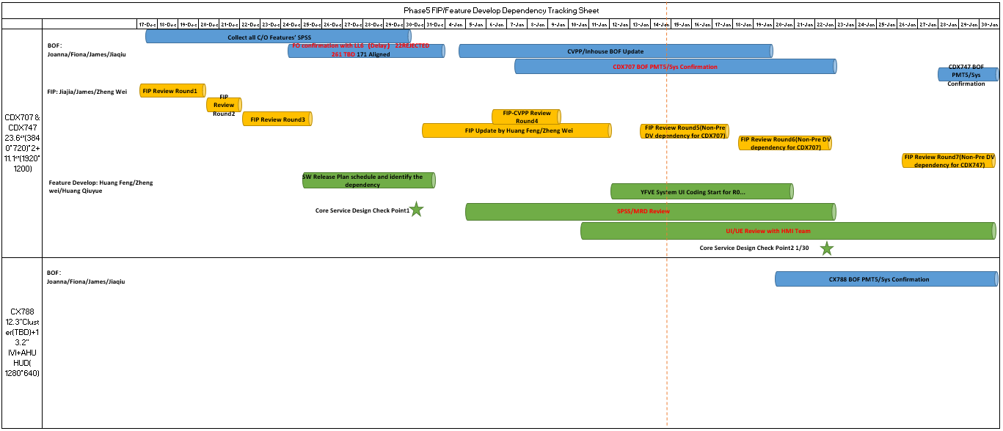
Phase5 FIP Tracking

Slide 4
CDX707 SW Release Plan
2021 | 2022 | 2023
1 | 2 | 3 | 4 | 5 | 6 | 7 | 8 | 9 | 10 | 11 | 12 | 1 | 2 | 3 | 4 | 5 | 6 | 7 | 8 | 9 | 10 | 11 | 12 | 1 | 2 | 3 | 4 | 5 | 6 | 7 | 8 | 9 | 10 | 11 | 12
CDX707 VPP
UPV2
UPV1
PA
FDJ
DCV
PEC
FEC
TT
PP
MP1
MP2
OKTB
02/19
05/28
06/11
06/30
07/14
08/06
08/20
01/19
02/02
05/30
06/13
07/11
07/25
07/26
08/02
10/11
10/18
03/28
03/01
CDC AHU HW
02/01
07/23-08/20
10/25-12/15
05/15-06/15
Pre-DV
B0 DV1
10/05
DV1
DV2
A0 PCBA
01/07 01/25
A1 PCBA
04/30
A2 Pre-DV
06/30
B1 DV2
04/15
Display(23.6+23.6,11.1 touch)
09/30-10/30
12/05-12/11
23.6 Pre-DV
03/22-06/09
11.1 EMC
23.6 DV
GPDS SW Version for MRD
DCV Beta
07/20
DCV2
01/05
R04
05/30
SW Release for REC
DCV0
10/27
DCV1
11/24
DCV3
02/16
R00
04/18
R05
07/06
R06
09/21
R07 12/06
Spring Festival
National Day
Spring Festival
National Day
Spring Festival
R15
05/18
R16
06/15
R17
07/13
R19
09/07
R20
10/19
R21
11/20
R22 for OKTB
01/15
R1
03/31
R4
06/23
R5
07/10，07/18
R10
12/15
R11
01/12
R12
02/23
R13
03/23
R14
04/20
R18
08/10
R0
03/03
R2
04/28
R3
05/26
R6
08/18
R7
09/15
R8
10/20
R9
11/17
Package 1-HW+Base SW
R15
04/20
R20
09/07
R21
10/19
R22 for OKTB
12/15
R0
02/23
R1
03/03
R2
03/31
R3
04/28
R4
05/26
R5
06/20
R6
07/21
R7
08/18
R8
09/15
R9
10/20
R10
11/17
R11
12/15
R12
01/12
R13
02/23
R14
03/23
R16
05/18
R17
06/15
R18
07/13
R19
08/10
Package 2-Ford core service
R15
04/20
R20
09/07
R21
10/19
R22 for OKTB
12/15
R0
02/23
R1
03/03
R2
03/31
R3
04/28
R4
05/26
R5
06/20
R6
07/21
R7
08/18
R8
09/15
R9
10/20
R10
11/17
R11
12/15
R12
01/12
R13
02/23
R14
03/23
R16
05/18
R17
06/15
R18
07/13
R19
08/10
Package 3-Eco APPs
R15
04/20
R20
09/07
R21
10/19
R22 for OKTB
12/15
Eng version for vendor’s internal release and test.
R0
02/23
R1
03/03
R2
03/31
R3
04/28
R4
05/26
R5
06/20
R6
07/21
R7
08/18
R8
09/15
R9
10/20
R10
11/17
R11
12/15
R12
01/12
R13
02/23
R14
03/23
R16
05/18
R17
06/15
R18
07/13
R19
08/10
Inhouse APPs
Eng version not necessary to release.
R15
04/20
R20
09/07
R21
10/19
R22 for OKTB
12/15
Pro version released for REC, focus and lite test.
R0
02/23
R1
03/03
R2
03/31
R3
04/28
R4
05/26
R5
06/20
R6
07/21
R7
08/18
R8
09/15
R9
10/20
R10
11/17
R11
12/15
R12
01/12
R13
02/23
R14
03/23
R16
05/18
R17
06/15
R18
07/13
R19
08/10
Package 4-HMI
Pro version released for REC, full test.
Group A for DCV Beta(R0-R5)
12/15 Delayed to 03/15 UE,04/30 UI
Cluster Assets 03/05
Group B for DCV1(R6-R9)
06/15
Group C for DCV3(R10-R11)
07/30
Group D for DCV2(R12-R13)
08/31

Slide 5
CDX707 SW Release Plan—HMI Risk
2021 | 2022 | 2023
1 | 2 | 3 | 4 | 5 | 6 | 7 | 8 | 9 | 10 | 11 | 12 | 1 | 2 | 3 | 4 | 5 | 6 | 7 | 8 | 9 | 10 | 11 | 12 | 1 | 2 | 3 | 4 | 5 | 6 | 7 | 8 | 9 | 10 | 11 | 12
CDX707 VPP
UPV2
UPV1
PA
FDJ
DCV
PEC
TT
PP
MP1
MP2
FEC
02/19
05/28
06/30
08/06
01/19
05/30
07/26
10/11
02/01
CDC AHU HW
07/11
03/01
07/10-08/05
10/25-12/15
05/15-06/15
Pre-DV
B0 DV1
10/05
DV1
DV2
A0 PCBA
01/25
A1 PCBA
04/30
A2 Pre-DV
06/30
B1 DV2
04/15
Display(23.6+23.6,11.1 touch)
09/30-10/30
12/05-12/11
23.6 Pre-DV
03/22-06/09
11.1 EMC
23.6 DV
GPDS SW Version for MRD
DCV Beta
07/20
DCV2
01/05
R04
05/30
SW Release for REC
DCV0
10/27
DCV1
11/24
DCV3
02/16
R00
04/18
R05
07/06
R06
09/21
R07 12/06
Spring Festival
National Day
Spring Festival
National Day
Spring Festival
R15
05/18
R16
06/15
R17
07/13
R19
09/07
R20
10/19
R21
11/20
R22 for OKTB
01/15
R1
03/31
R4
06/23
R5
07/10，07/18
R10
12/15
R11
01/12
R12
02/23
R13
03/23
R14
04/20
R18
08/10
R0
03/03
R2
04/28
R3
05/26
R6
08/18
R7
09/15
R8
10/20
R9
11/17
Package 1-3-HW+Base SW
R15
04/20
R20
09/07
R21
10/19
R22 for OKTB
12/15
CAN’T MEET Pre DV/DCV/PEC Requirement.
R0
02/23
R1
03/03
R2
03/31
R3
04/28
R4
05/26
R5
06/20
R6
07/21
R7
08/18
R8
09/15
R9
10/20
R10
11/17
R11
12/15
R12
01/12
R13
02/23
R14
03/23
R16
05/18
R17
06/15
R18
07/13
R19
08/10
Issue3:
IVI UE release plan has been delayed by 3 months; R5 will be delayed, Pre-DV will be delayed by 3 months.
IVI UE Plan- Jan.15 Update
Group A
12/15
Group B
02/15
Group A
03/15
Group B
04/30
Group C
05/31
Group D
06/30
Issue2:
UI has been delayed by 4 months, Uncertain Hero-screen release plan may cause the further delay of UI.
IVI UI Plan- Jan.15 Update
Group A
12/15
Group B
02/15
Group A
04/30
Group B
06/15
Group C 07/30
Group D 08/31
Issue1:
Uncertain Cluster UX release plan， Pipeline design can’t be frozen in R1.
Pro version released for REC, focus and lite test.
Pro version released for REC, full test.
Cluster UX Plan- Unclear

Slide 6
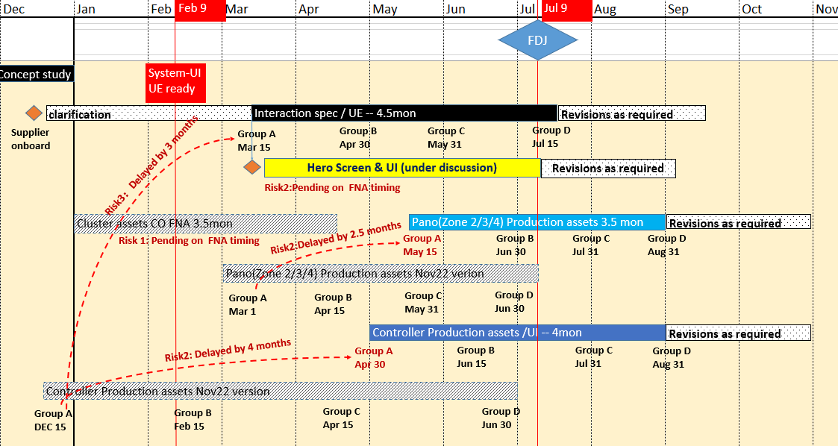
CDX707 HMI Release Plan--IVI
Issue1: Uncertain Cluster UX release plan.
Issue2: Uncertain Hero-screen release plan may cause the further delay of UI.
Issue3: IVI UE release plan has been delayed by 3 months; R5/Pre-DV maybe be delayed, Pre-DV will be delayed by 3 months.
.

Slide 7
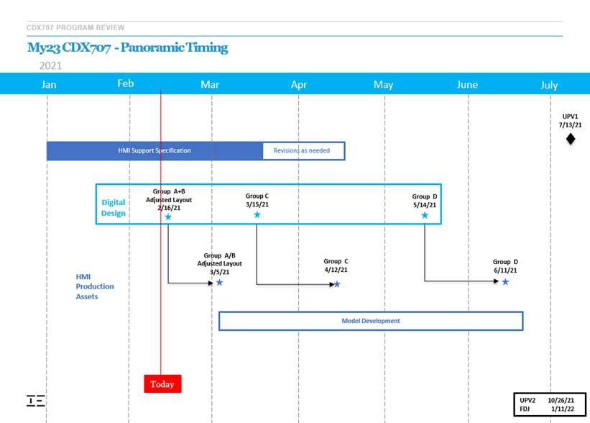
CDX707 HMI Release Plan--Cluster
To Be Confirmed by YFVE Team.

Slide 8
CDX747 SW Release Plan--TBD
2021 | 2022 | 2023
1 | 2 | 3 | 4 | 5 | 6 | 7 | 8 | 9 | 10 | 11 | 12 | 1 | 2 | 3 | 4 | 5 | 6 | 7 | 8 | 9 | 10 | 11 | 12 | 1 | 2 | 3 | 4 | 5 | 6 | 7 | 8 | 9 | 10 | 11 | 12
CDX747
UPV0
UPV1
UPV2
FDJ
DCV
PEC
FEC
TT
PP
MP1
MP2
OK2B
01/11
03/13
06/12
10/09
CDC AHU HW
04/06
07/13
10/26
07/11
11/01
11/29
12/12
11/06
07/23-08/20
10/25-12/15
05/15-06/15
Pre-DV
B0 DV1
10/05
DV1
DV2
A0 PCBA
01/07 01/25
A1 PCBA
04/30
A2 Pre-DV
06/30
B1 DV2
04/15
Suppose the same with CDX707
Display(23.6+23.6,11.1 touch)
09/30-10/30
12/05-12/11
23.6 Pre-DV
03/22-06/09
11.1 EMC
23.6 DV
GPDS SW Version for MRD
DCV Beta
12/15
DCV2
07/05
R04
10/17
R06
02/13
R07 05/06
SW Release for REC
DCV0
04/10
DCV1
05/10
DCV3
08/11
R00
9/15
R05
11/06
Spring Festival
National Day
Spring Festival
National Day
Spring Festival
R28
07/28
R25
04/28
R29
08/28
R30 for OKTB
09/28
R15
05/18
R16
06/15
R17
07/13
R19
09/07
R20
10/19
R21
11/20
R22
01/15
R23
02/28
R24
03/28
R1
03/31
R4
06/23
R5
07/10，07/18
R10
12/15
R11
01/12
R12
02/23
R13
03/23
R14
04/20
R18
08/10
R0
03/03
R2
04/28
R3
05/26
R6
08/18
R7
09/15
R8
10/20
R9
11/17
R27
06/28
R26
05/28
Package 1-HW+Base SW
R15
04/20
R20
09/07
R21
10/19
R22
12/15
R0
02/23
R1
03/03
R2
03/31
R3
04/28
R4
05/26
R5
06/20
R6
07/21
R7
08/18
R8
09/15
R9
10/20
R10
11/17
R11
12/15
R12
01/12
R13
02/23
R14
03/23
R16
05/18
R17
06/15
R18
07/13
R19
08/10
Package 2-Ford core service
R15
04/20
R20
09/07
R21
10/19
R22
12/15
R0
02/23
R1
03/03
R2
03/31
R3
04/28
R4
05/26
R5
06/20
R6
07/21
R7
08/18
R8
09/15
R9
10/20
R10
11/17
R11
12/15
R12
01/12
R13
02/23
R14
03/23
R16
05/18
R17
06/15
R18
07/13
R19
08/10
Package 3-Eco APPs
R15
04/20
R20
09/07
R21
10/19
R22
12/15
Eng version for vendor’s internal release and test.
R0
02/23
R1
03/03
R2
03/31
R3
04/28
R4
05/26
R5
06/20
R6
07/21
R7
08/18
R8
09/15
R9
10/20
R10
11/17
R11
12/15
R12
01/12
R13
02/23
R14
03/23
R16
05/18
R17
06/15
R18
07/13
R19
08/10
Inhouse APPs
Eng version not necessary to release.
R15
04/20
R20
09/07
R21
10/19
R22
12/15
Pro version released for REC, focus and lite test.
R0
02/23
R1
03/03
R2
03/31
R3
04/28
R4
05/26
R5
06/20
R6
07/21
R7
08/18
R8
09/15
R9
10/20
R10
11/17
R11
12/15
R12
01/12
R13
02/23
R14
03/23
R16
05/18
R17
06/15
R18
07/13
R19
08/10
Package 4-HMI
Pro version released for REC, full test.
Group A for DCV Beta
12/15 Delayed to 03/15 UE,04/30 UI
Group C for DCV1
07/30
Group D for DCV2
08/31
Group B for DCV0
06/15

Slide 9
CX707 SW Release Requirement for MRD
R-Event | Software Maturity | Corresponding Milestone | Release Due Date^{*1)} | Build Support
TPB | Fully verified on component level | TPV BB MRD - 1 week | 9/9/2019 | Support TPV BB and TPV T&C MRD
TP3 | Updates Release | TDC - 2weeks | 1/22/2021 | Support TDC
DCV beta | System test on engineering prototype | eBB MRD | 8/6/2021 | Support FDJ
DCV 0 | Fully verified on component level | DCV BB MRD - 4 weeks | 10/27/2021 | Support <DCV BB> MRD and HiL MRD
DCV 1 | Updates Release | T/C MRD - 4 weeks | 11/24/2021 | Support <T/C> MRD
DCV 2 | Updates Release | DCV - 2 weeks | 1/5/2022 | Breadboard update, DCV vehicles update
DCV 3 | Updates Release | DCV+ 4 weeks | 2/16/2022 | Breadboard update, DCV vehicles update
R00 | Feature DV complete. | PEC - 6 weeks | 4/18/2022 | DCV vehicles update for PEC Sign-off
R04 | Feature DV signed off | FEC - 6 weeks | 5/30/2022 | DCV vehicles update for FEC Sign-off
R05 | Fully Validated Release | TT MRD - 4 weeks | 7/6/2022 | Support <TT> MRD
R06 | Fully Validated Release | PP MRD - 4 weeks | 9/21/2022 | Support <PP> MRD
R07 | Fully Validated Release | MP1/J1 MRD - 4 weeks | 12/6/2022 | Support <MP1> MRD

